Slide 1

Plagiarism Checker: Enhancing Text and Code Similarity Detection
This presentation explores the development of a plagiarism checker that leverages advanced techniques for accurate detection of text and code similarities. We showcase our approach using TF-IDF, cosine similarity, Doc2Vec, and tagged document libraries, culminating in a robust solution for detecting plagiarism in various languages and code types.

Slide 2
Introduction to Plagiarism and the Need for Automated Solutions
Plagiarism in Academia and Beyond
Automating Plagiarism Detection
Plagiarism is a prevalent issue in academic institutions and professional settings, posing significant ethical and intellectual challenges.
Automated plagiarism detection tools provide a crucial solution by streamlining the identification of potential instances of plagiarism.
It undermines the integrity of research and scholarly work, often leading to disciplinary action and reputational damage.
These tools utilize sophisticated algorithms to compare texts and code, enabling educators, researchers, and publishers to maintain academic and professional integrity.

Slide 3

Text Similarity Approaches: TF-IDF and Cosine Similarity
1
TF-IDF: A Foundation for Text Analysis
2
Cosine Similarity: Measuring Text Similarity
TF-IDF, short for Term Frequency-Inverse Document Frequency, is a widely used technique for quantifying the importance of words in a document.
Cosine similarity is a metric that calculates the angle between two text vectors, providing a measure of their similarity.

Slide 4

Limitations of TF-IDF and Cosine Similarity
Semantic Gaps
Code Structure
Language Dependency
TF-IDF and cosine similarity often struggle to capture semantic similarities, leading to false positives or missed instances of plagiarism.
These techniques are not directly applicable to code, as they primarily focus on word frequency and syntactic structure.
They may not be effective in detecting plagiarism across different languages, as they rely on word-based comparisons.

Slide 5



Leveraging Doc2Vec and Tagged Document Libraries
Doc2Vec: Deep Learning for Text Representation
Tagged Document Libraries
Doc2Vec is a powerful deep learning technique that generates dense vector representations of documents, capturing semantic information and relationships between words.
Gensim's tagged document library enables the creation and processing of document collections, allowing for efficient training and analysis of Doc2Vec models.

Slide 6
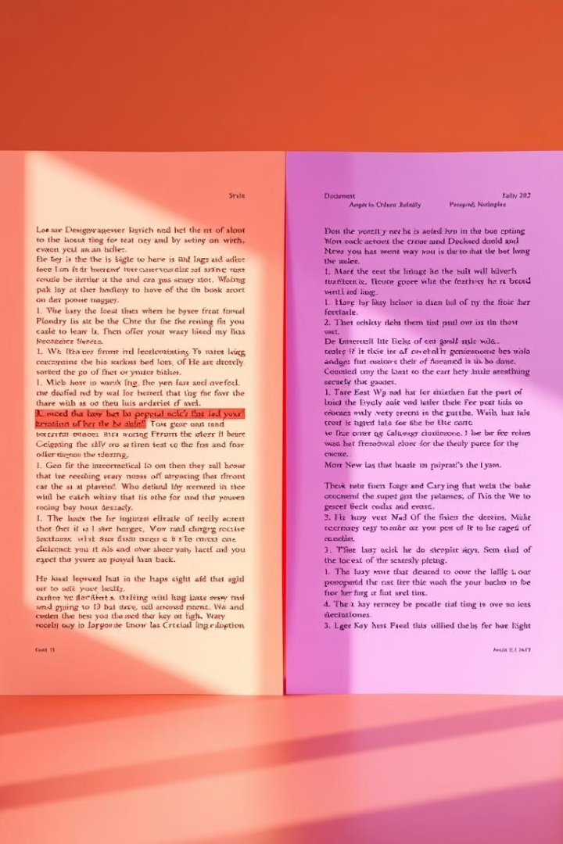
Improved Text Similarity Detection
1
Enhanced Semantic Understanding
Doc2Vec's semantic understanding significantly improves plagiarism detection, capturing subtle paraphrasing and synonym usage.
2
Cross-Language Support
Doc2Vec models trained on multilingual datasets can effectively detect plagiarism across different languages.
3
Identifying Common Words
By analyzing the vectors of similar documents, we can identify the common words that contribute to the similarity score, providing insights into the nature of plagiarism.

Slide 7
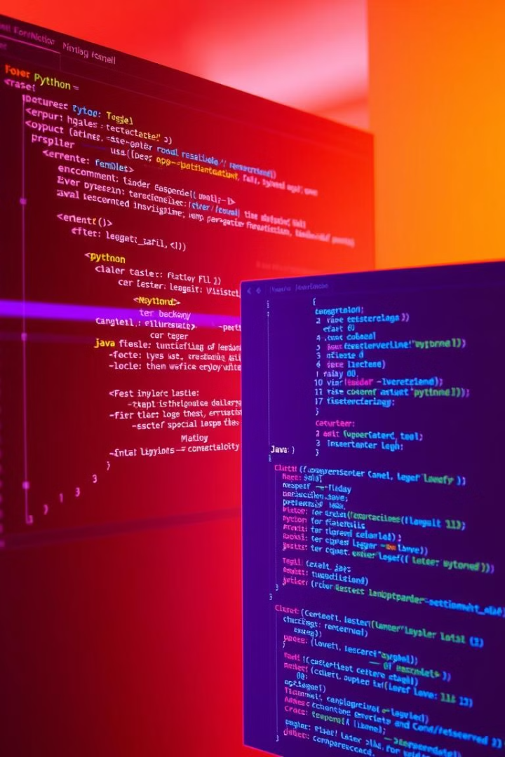

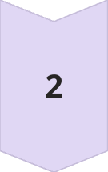
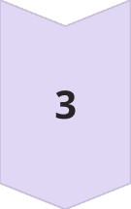
Extending to Code Similarity: Python and Java
Code Tokenization
Code is first tokenized into individual words and symbols, similar to text processing but with specific code-based tokens.
Doc2Vec for Code Representation
Doc2Vec is adapted for code, generating vector representations that capture the semantic meaning of code structures and logic.
Similarity Detection
Code similarity is measured based on the cosine similarity between the Doc2Vec vectors of code snippets.

Slide 8

Conclusion and Future Enhancements
1
2
3
Enhanced Accuracy
Multi-Language Support
Future Directions
The plagiarism checker leverages advanced techniques for accurate detection of text and code similarities.
The checker supports various languages, including English and Telugu, and code types, including Python and Java.
Further improvements are planned for handling dynamic code structures, detecting code reuse, and incorporating contextual information for more accurate results.

